Slide 1
Lab 2: Requirements analysis
Vu Tuan Hai

Slide 2
Week | Topic | Homework
1 | Overview about the workspace of a software engineer | Project plan Setup workspace
2 | Analysis | Usecase diagram Sequence diagram
3 | Design | Class diagram Database diagram UI / UX prototype
4 | Implement | N/A (coding)
5 | Testing | N/A (coding)
6 | Evaluation the project | Complete project

Slide 3



Analysis
Requirement analysis is an action that turns human language into SE language.
Usecase diagram
Class diagram
I would a software that can ABC, XYZ
Analysis
Sequence diagram
…
Note that we only deal with simple requirements.
In this week, we learn how to create usecase & sequence diagram

Slide 4
UML Diagram
Almost all diagrams are visualized by UML (Unified Modeling Language)
UML is a language for the specification, visualization, construction, and documentation of software systems. It includes rules, shapes, symbols, …
Usecase diagram describes what function the software must have.
Sequence diagram describes how software functionality works based on the interactions between components in the system.
Class diagram describes what class the software must have.

Slide 5
Sample project - Jewelry store management
Requirements:
The website allows normal users to view items online, employees can input bills while buying offline and manage import/export items. The manager can manage employees and know store revenue.
I would show items on the homepage. The best selling items will on the top, the other items are cluster by category.

Slide 6
Usecase diagram
First step: define actor - who can use software
What type of actors are needed in requirement?

Slide 7
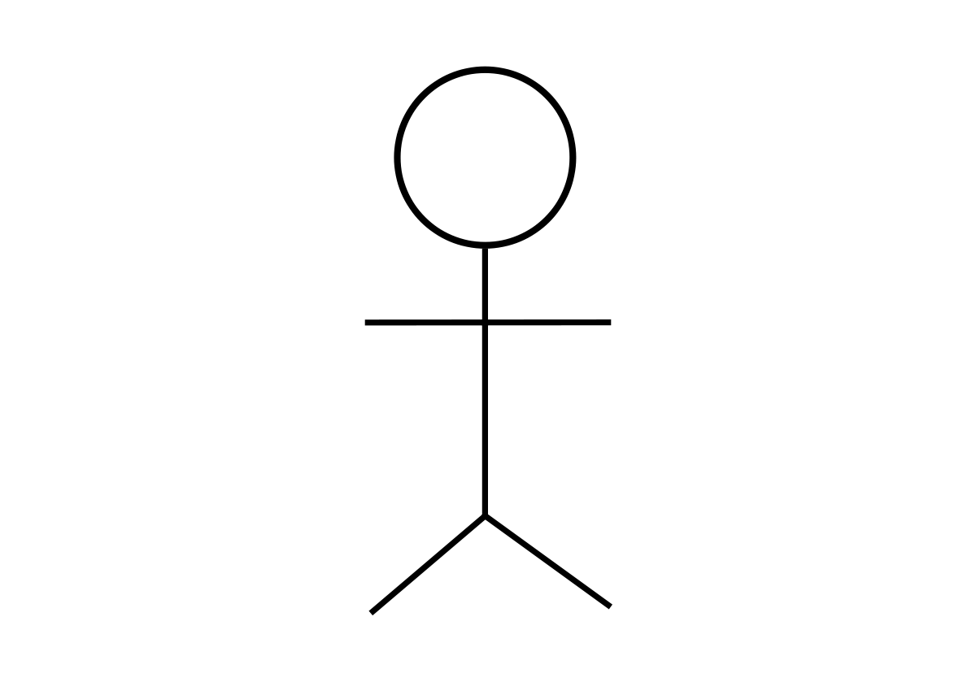
Usecase diagram
User
Employee
Manager
Use UML
User
Employee
Manager

Slide 8
Usecase diagram
Second step: define usecase - the function that the actors will use
What functions are needed in requirement?

Slide 9
Usecase diagram
Association
Usecase
Register
User
User:
Sign in, Sign out
Register, Read items
Employee:
Sign in, Sign out
Create bill
CRUD item and its quantity
CRUD user
Manager:
Sign in, Sign out, Register
CRUD employee
Sign in
Sign out
Use UML
Employee
CRUD item
CRUD employee
Manager
These are needed separate

Slide 10
Usecase diagram
Third step: define relationships between actor and actor, usecase and usecase, actor and usecase.

Slide 11
Generalization
Register
Register
Sign in
User
User
Sign in
Sign out
Sign out
Read item
Employee
Manage
CRUD item
<<extend>>
Update
item
CRUD employee
<<include>>
Manager
<<include>>
Employee
CRUD item
These are needed separate

Slide 12
Register
Signin
User
Signout
Create bill
Read items
Employee
<<include>>
Create items
<<include>>
CRUD items
Update items
<<include>>
Manager
<<include>>
Delete items

Slide 13
Usecase diagram
Fourth step: draw by PowerPoint, Visio or draw.io

Slide 14
Exercise
A company specializing in the business of electronic devices wants to build an e-commerce system.
The new system must ensure that customers visiting the website can easily select products, view promotions and make purchases. Payment can be made online or in-store. Customers can receive goods at the store or use delivery service.
In addition, the system also needs a module to ensure the company manages business activities such as the quantity of goods in stock, order management, delivery status, payment, etc.

Slide 15
Cart / Purchase
Search
View product
<<include>>
View detail
Buy
View promotion
User
Login / Logout
Account
<<include>>
Register
Item management
Order status
Seller
Order management
<<include>>
Support customer

Slide 16
Sequence diagram
Object
:User
:LoginTab
:Backend
1. Enter username / pass
Object
2. Login()
3. Validate()
Stimulus (message)
4. Message()
alternatives
alt
5.1. Message()
[If Message() is Success]
6.1. GoTo
Home()
[else]
5.2. Message()
6.2. Do
Nothing()
Time

Slide 17
Sequence diagram
First step: define the function by getting information from Usecase diagram

Slide 18
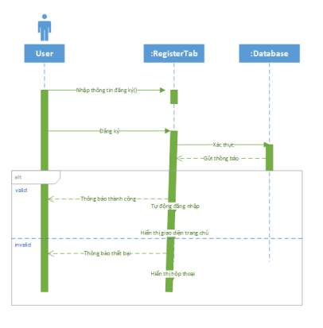
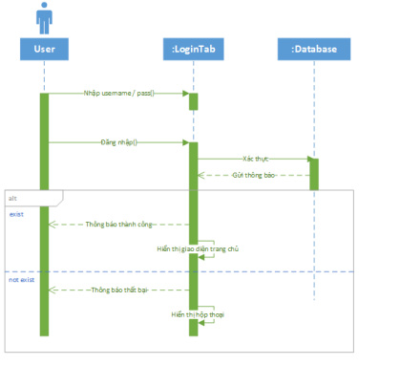
Sequence diagram
Register
Sign in
Sequence diagram of Register
User
Sign out
Sequence diagram of Sign in / Sign out

Slide 19
Sequence diagram
Second step: base on Activity diagram (Algorithm) and business, defining procedures of the diagram.
:username
:password
Input
Validate
Message
success
Go to homepage
fail

Slide 20
Sequence diagram
Third step: determine the class in the system that participates in the business.
User
:username
Backend
Frontend
:password
Input
Validate
Message
success
Go to homepage
fail

Slide 21
Sequence diagram
Fourth step: draw!

Slide 22
Exercise
A library is doing the digitization of book management.
Readers can view book information online based on book title.

Slide 23
:User
:ViewTab
:ReadBook
:dbBook
1. Enter book title
2. Request()
3. Request()
4. result
5. result
alt
5.1. Return result()
[If len(result) > 0]
6.1. DisplayBook()
[else]
5.2. Return result()
6.2. MessageNotFound()

Slide 24
Homework
Usecase, Sequence diagram for your project
(2 weeks)
Upload your results on the Github repository

Slide 25
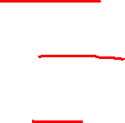
Class diagram
Class name
Composition
ACCOUNT
Username Hash Type
Update()
DETAIL_BILL
…
Attribute
CUSTOMER
Name
…
Method
Association
EMPLOYEE
Name: String Manager: Employee
UpdateName(String newname): Boolean
ITEM
Name Price Type
…
BILL
Date Type
…
Generalization
IMPORT_BILL
…
…
Detailed class

Slide 26
Class diagram
The class diagram is the hardest diagram. Defining classes base on:
- Requirement
- Usecase diagram
Entity => Attribute => Method => Relationship

Slide 27

Database diagram
Table
ACCOUNT
ID (PK) Username Hash Type
Key
DETAIL_BILL
ID_Bill (FK) ID_Item (FK)
CUSTOMER
ID (PK) ID_Account (FK) Name
Field
Relatiopship
ITEM
ID (PK) Name Price Type
EMPLOYEE
ID (PK) ID_Account (FK) Name ID_Manager
BILL
ID (PK) ID_Customer (FK) ID_Employee (FK) Date Type
IMPORT_BILL
…

Slide 28
Database diagram
Map classes to tables:
- Add key
Attribute => Field
Relationship => Foreign Key

Slide 29
Exercise
Library management database
Quản lý sách trong thư viện:
Sách
Người đọc
Phiếu mượn đọc
…

Slide 30
Homework
Research about business (ref Git/References/SampleBAReport)
Draw database diagram of your project.
Deadline: 2 weeks.

Slide 31
Question

